Slide 1


Slide 2


Slide 3


Slide 4


Slide 5
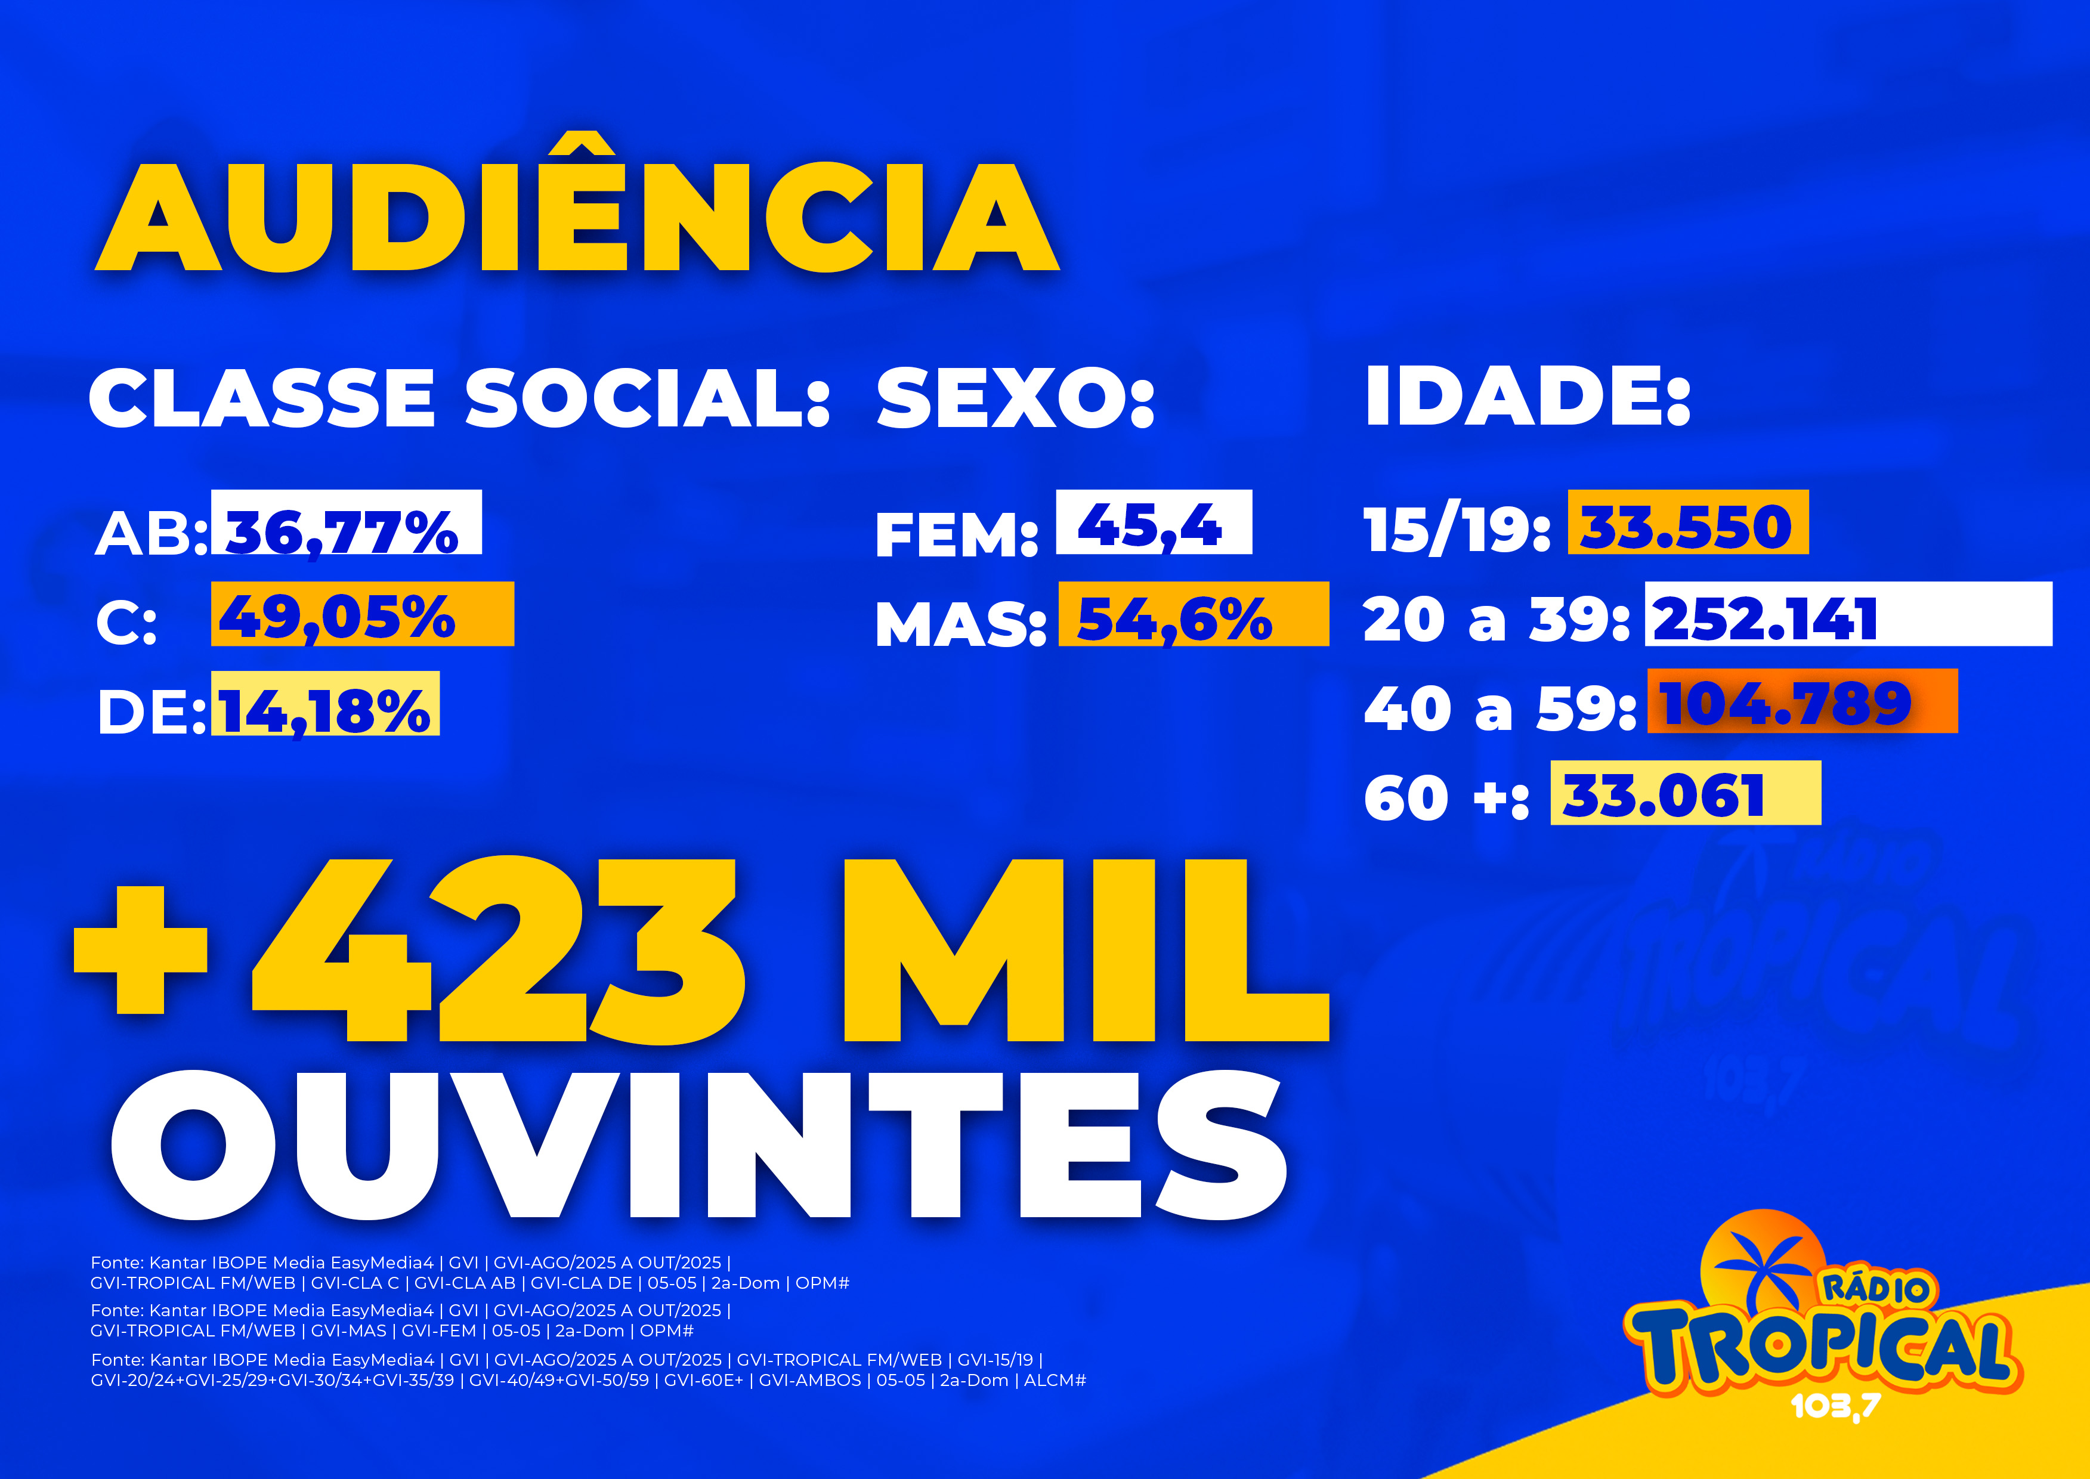




Slide 6


Slide 7


Slide 8



(27) 9999.9999

